Slide 1

Bus Tracking System
Android Application

Slide 2
About us
Group Name: Android Developers
Group Members:
Anurag Chitnis
Satyanarayana Chivukula
Nitesh Kumar Sharma
Gill Wasserman

Slide 3
Project Description
Motivation – Current UNT bus system, problems
Major Functions
tracking of buses and e-ride using GPS
Route information and schedule on google map
Development Environment
Android Studio
GitHub
Slack

Slide 4
Team member Responsibilities
Anurag Chitnis
Tracker Map Activity Class
Sign In Activity
Code Integration
Test Cases
Nitesh Sharma
About Us Class
Facebook Page Integration
Dataset Creation
Test Cases

Slide 5
Team member Responsibilities
Gil Wasserman
Route List Activity class
Firebase model classes
Code integration
Test Cases
Satyanarayana
Location Sharing Service
Sign In Activity
Code Integration
Test Cases

Slide 6
Core Requirements
List of all the routes with schedule
Tracking of buses
Show Bus stops, schedule on Map
Offline caching
Notifications to user
Driver Login and location sharing
Easy management

Slide 7
Implementation Details
Language
Java
Platform
Android Studio Package
Software
Android Studio 2.2.2.0
Firebase Database

Slide 8
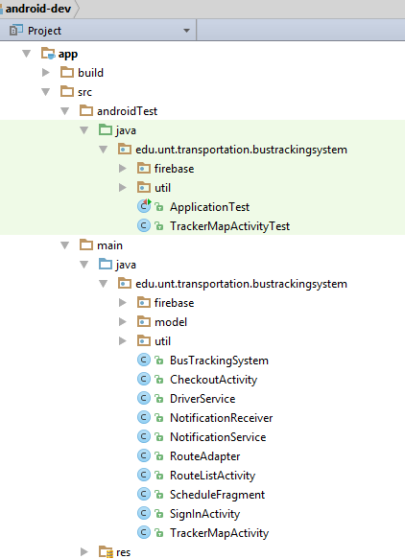
Implementation details

Slide 9
Feedback from peer review
At the time of design, our test plan was very generic and few test cases were planned.
Unit testing alone is not just enough to test Android Application.
We came up using Espresso framework that does UI testing, however, unit test cases are also used as needed.

Slide 10
Feedback from peer review
Non-functional requirements where not specific.
Regarding safety and security:
At user level, we decided create individual user ids for all drivers
On the other hand, at system level, our app must use GPS and, Location Services with the users’ permission.
About availability, we check internet connectivity to ensure service is available.

Slide 11
Code inspection
Response from the code inspection team was promising.
Header blocks were duly commented, describing:
Author
Revised By
Created on
Description
Variable names were meaning with functionality.
Properly formatted as per java language specification.

Slide 12
Limitation
We couldn’t draw the line along the route, because of limited set of data points of the location.
We need to study more on GoogleMapClient API and location services, to get the normalized (smoothened) location points.
Implementing the two above goes beyond project plan, but certainly are implementable.

Slide 13
Testing
JUnit testing
Local and instrument tests
Use of firebase test-lab
Robo test
Instrument test
Demo of test-lab and results

Slide 14
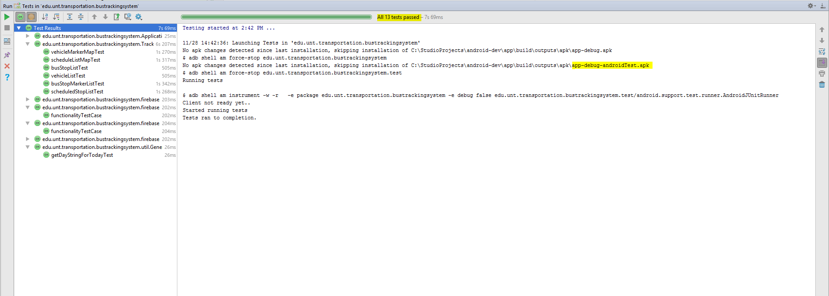
Testing in Android studio

Slide 15
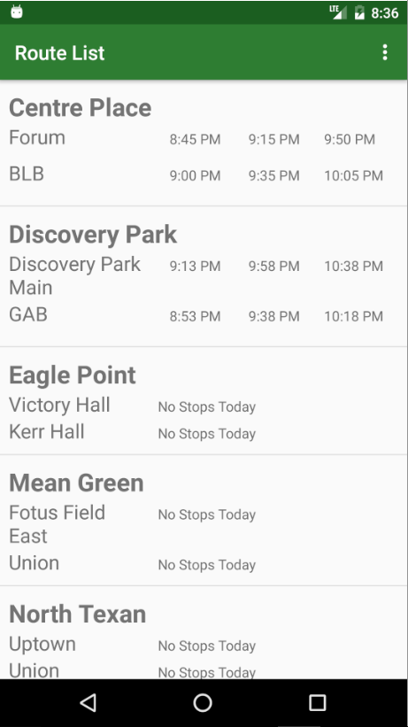
App in action
Launcher View
Displays All Routes
Shows Scheduled Stops
Display Next 3 Stop Times

Slide 16
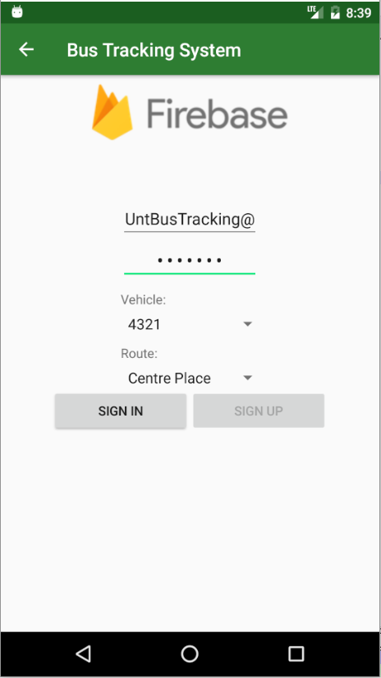
App In Action
Driver Sign In
Requires Authorized Account To Sign-In
Driver Selects Route And Vehicle ID
Initializes Vehicle Tracking On Sign-In

Slide 17
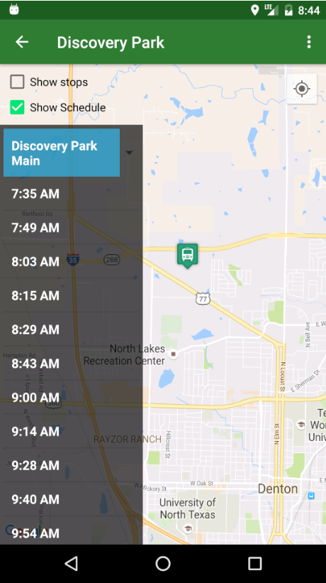
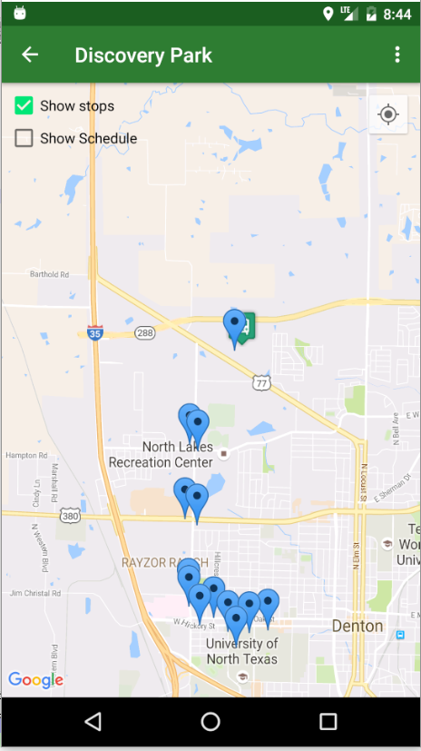
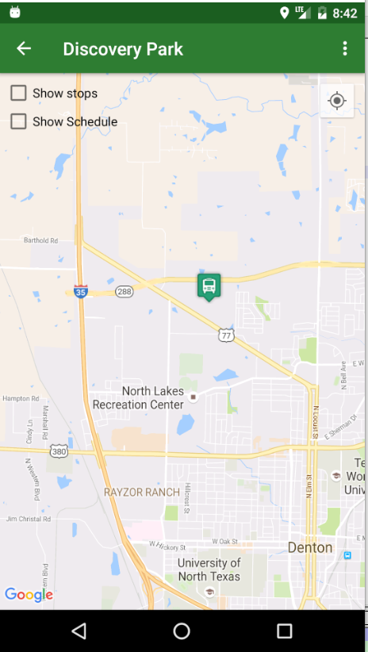
App In Action
Vehicle Tracking
Displays Bus Icon For Vehicle Location
Optional Display of Stop Locations
Optional Display of Full Stop Schedule

Slide 18
Live Demo

Slide 19
Thank You!

